Slide 1
My App Description
My app is a e-commerce web site for my project (May Designs déco).
It is a site for the sale of decorative paintings printed online.

Slide 2
In my app, there is 2 actors: admin and custumer
Gérer Product
Admin
Gérer Orders
S’authentifier
Gérer utilisateurs

Slide 3
Make order
Custumer
Gérer Panier
S’authentifier
Payment

Slide 4
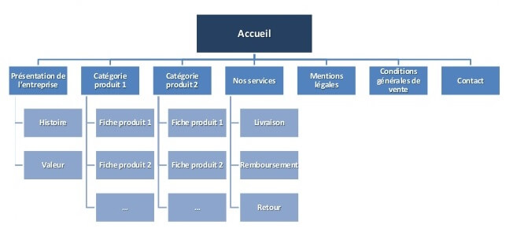
The aim of my web site application
is to improve the rate of sale of our paintings

